Slide 1
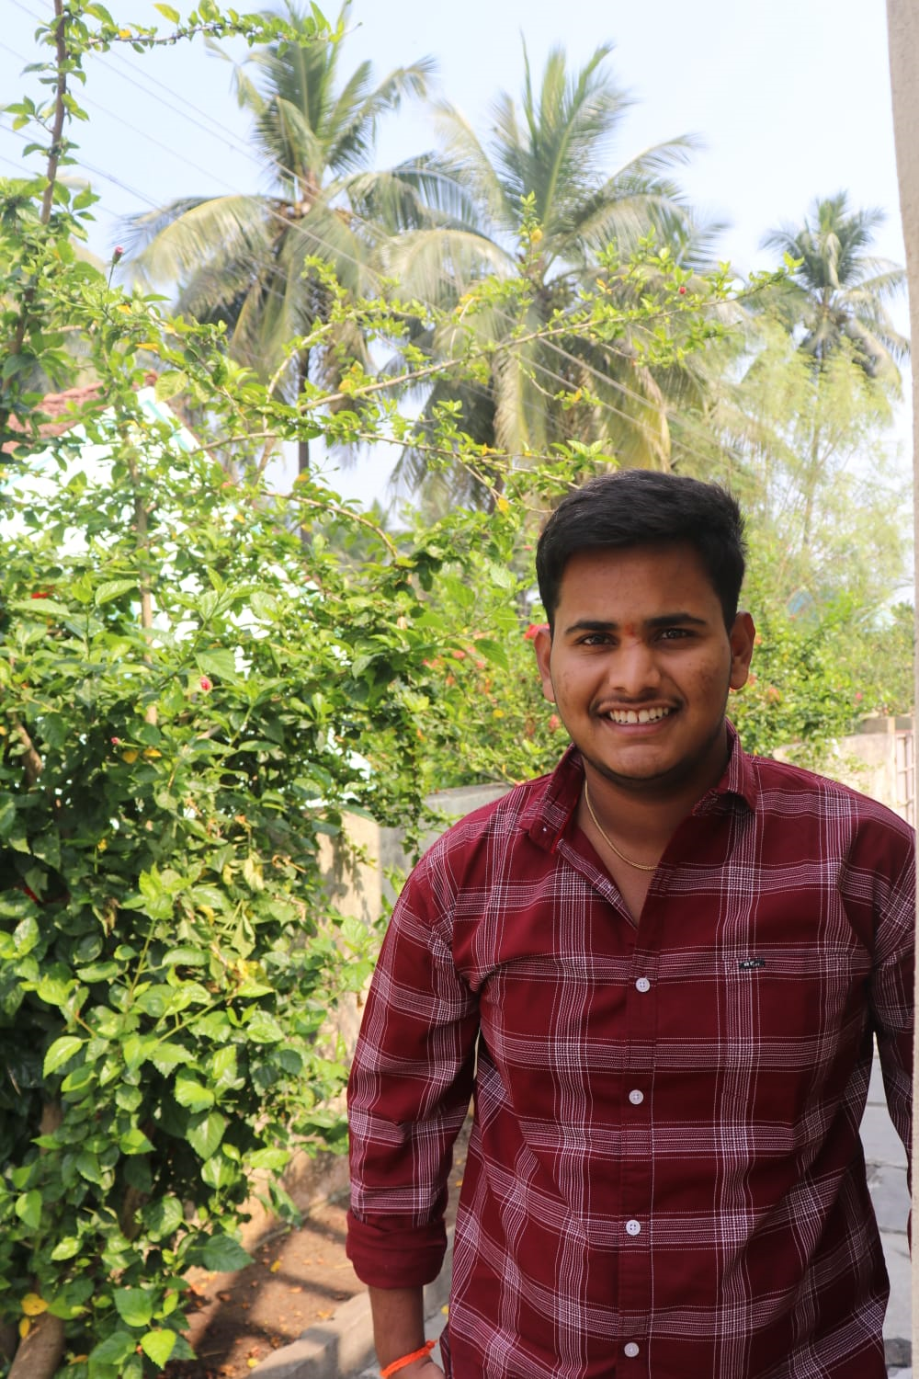

Student Details
Name : Dwarampudi kodanda rama venkata narsi reddy
Reg No: AP22110010626
Skills build email id: kodandaramavenkatanarsireddy_d@srmap.edu.in
College name: sRm university
College state : Andhra Pradesh
Internship domain: cyber security using kali linux
Start date and end date::07/06/2024-12/07/2024

Slide 2
Image steaganography
Creating an effective and robust steganographic technique for embedding and extracting hidden information in a digital image involves several crucial steps. The goal is to ensure that the hidden data is imperceptible(undetected) to the human eye and does not cause distortion or noticeable noise during typical image processing operations.

Slide 3
AGENDA
The goal is to create a robust and efficient method for embedding and extracting hidden messages within images while maintaining their visual quality. This technique should be resilient to common image processing operations such as compression, resizing, and format conversion, as well as typical geometric attacks and degradation. The method should ensure the integrity and confidentiality of the hidden information despite manipulations by adversaries. The aim is to achieve a balance between robustness and efficiency, preserving both the confidentiality and authenticity of the hidden data under various forms of manipulation.

Slide 4
PROJECT OVERVIEW
The main goal of this image steganography project is to develop a powerful tool that can effectively embed and extract hidden messages from digital images. To achieve this, the project will first involve an in-depth study to understand the strengths and weaknesses of different steganography techniques, with an emphasis on Least Bit (LSB) insertion. Subsequently, message upload and download algorithms will be improved, performance and security will be improved. Project will create a user-friendly interface for easy installation and download. Extensive testing will be conducted to determine the device's performance and its strength against image processing attacks such as compression and noise. Deliverables include a comprehensive steganography toolset, detailed research and development documentation, and a summary of project objectives, methods, results, and conclusions . The project aims to improve data privacy and provide important insights into digital imaging and cryptography.

Slide 5
WHO ARE THE END USERS of this project?
Cybersecurity Experts: Professionals focused on securing information and communication systems from unauthorized access or modifications. Corporate Executives: Executives who need to share confidential business information securely. Cryptography Researchers: Scholars studying secure communication methods. Computer Science Students: Students learning about digital image processing, cryptography, and information security. Privacy-Conscious Individuals: People who value privacy and wish to protect their communications from eavesdropping. Technically Savvy Users: Individuals interested in using advanced tools to secure their data. These users would benefit from a tool that allows them to securely embed and extract messages within digital images, ensuring that sensitive information can be transmitted covertly and securely.

Slide 6
YOUR SOLUTION AND ITS VALUE PROPOSITION
My solution is the first steganography tool designed to effectively embed and extract hidden messages from digital images. The use of modern technology that increases the security and control of encrypted data ensures that messages remain unnoticed by unauthorized persons. Advanced steganography systems are needed to accurately place and recover confidential information in digital images. The system uses complex algorithms to ensure that confidential information does not interfere with normal video processing operations such as editing, blocking and resizing and remains hidden from the public. Anti-editing capabilities: The system is designed to withstand common video operations such as compression, editing, and reformatting, ensuring that the 's embedded data remains unchanged and maintains its integrity despite these changes.

Slide 7
How did you customize the project and make it your own
I reviewed many books to adapt and improve the steganography project and chose the Basic Bit Insertion (LSB) method to balance simplicity and performance. . Extensive testing has been conducted to improve the tool's performance and vulnerability to common video processing attacks. Automation and integration of the Steganography project has been solved with the solution that interests users including security experts, government agencies and companies. This includes the use of modern algorithms aimed at making data security stronger and better . It will remain strong in many image processing applications, but with better performance. Quality testing and validation are also performed on the system using realistic scenarios and include user feedback to create a solution that meets user expectations and unique needs

Slide 8
MODELLING
Project Modelling: Image Steganography Tool
System Architecture:
The system is divided into three main components:
1. User Interface: Facilitates user interactions, built using Tkinter or Flask.
2. Core Algorithms: Embedding and extraction logic for hiding and retrieving messages.
3. Data Handling: Manages image input/output and message processing.
Data Flow:
1. Input:
- Users provide an image file, a secret message, and a password.
2. Processing:
- The message is appended with a terminator character.
- The password is hashed using SHA-256.
- The message is embedded in the image using LSB method and hashed password.
3. Output:
- The stego-image is saved and displayed.
- Hidden messages can be retrieved using the hashed password.

Slide 9
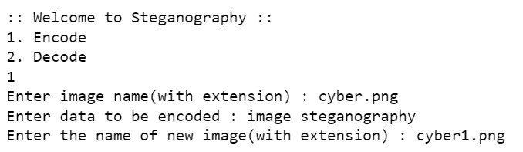
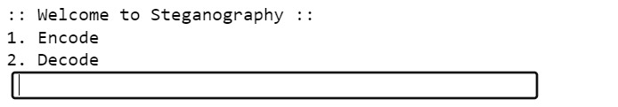
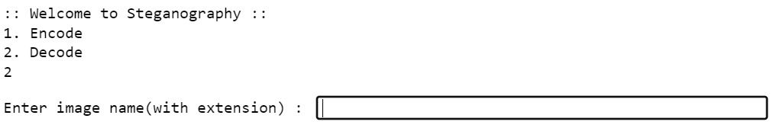
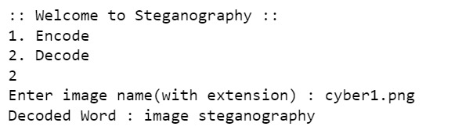
Results

Slide 10
links
https://github.com/Helium-He/Image-Steganography
https://www.javatpoint.com/image-steganography-using-python
https://www.geeksforgeeks.org/image-based-steganography-using-python/

